Slide 1
Linear Discriminant Analysis (LDA)
These slides are taken from Prof. Jiashi Feng’s slides.

Slide 2
Supervised vs. Unsupervised Learning
Supervised learning
Supervision: The data (observations, measurements, etc.) are labeled with pre-defined classes. It is like a “teacher” gives the classes (supervision).
Test data are classified into these classes too.
Unsupervised learning
Class labels of the data are unknown
Given a set of data, the task is to find subspaces, latent factors, clusters in the data.

Slide 3
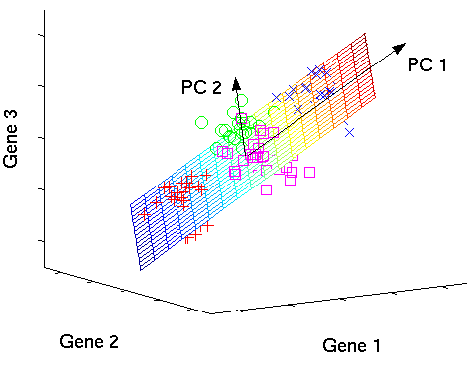
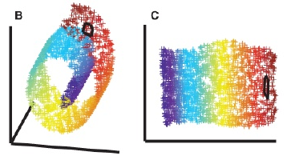
Linear Subspace vs. Manifold
Unfolding the Swiss roll

Slide 4
Linear
PCA
LDA
NMF
Non-supervised
supervised
Clustering
Kernel PCA
Graph Embedding
Non-linear

Slide 5
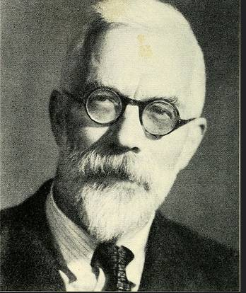
A Bit History
Linear Discriminative Analysis
Fisher’s Linear Discriminative Analysis (1936)
Fisher, R. A. (1936). "The Use of Multiple Measurements in Taxonomic Problems". Annals of Eugenics.
Linear Discriminative Analysis (1948)
Rao, R. C. (1948). "The utilization of multiple measurements in problems of biological classification". Journal of the Royal Statistical Society, Series B.
Manifold Learning
Isomap
Tenenbaum, et al. “A Global Geometric Framework for Nonlinear Dimensionality Reduction”, Science 2000.
Locally Linear Embedding (LLE)
Roweis, et al, “Nonlinear Dimensionality Reduction by Locally Linear Embedding”, Science 2000.
Graph Embedding (GE)
Yan et al., Graph embedding and extensions, TPAMI, 2007.
Ronald Fisher (1890-1962)
“A genius who almost single-handedly
created the foundations
for modern statistical science“ – Anders Hald

Slide 6
Supervised Feature Extraction: Linear Discriminant Analysis

Slide 7
Is PCA a Good Criterion for Classification?
Data variation determines the projection direction
What’s missing?
Class information
Why is class information useful?
PCA
direction

Slide 8
What is a Good Projection?
What is a good criterion?
Separating different classes
Two classes overlap
Two classes are separated

Slide 9
What Class Information May be Useful?
Between-class distance
Distance between the centroids of different classes
Should be large or small?
Between-class distance

Slide 10
What Class Information May be Useful?
Between-class distance
Distance between the centroids of different classes
Within-class distance
Accumulated distance of an instance to the centroid of its class
Should be large or small?
Within-class distance

Slide 11
Linear Discriminant Analysis
Linear discriminant analysis (LDA) finds most discriminative projection by maximizing between-class distance and minimizing within-class distance

Slide 12
Linear Discriminant Analysis
Linear discriminant analysis (LDA) finds most discriminative projection by maximizing between-class distance and minimizing within-class distance

Slide 13
Statistical Facts (1) Quantity for Measuring Within and Between Class Distance
Class-specific mean vector (sample):
Class-specific covariance (scatter) matrix:
Total mean vector (sample):
What are x, 𝜇, 𝜇_{i}, n_{i} N?

Slide 14
Statistical Facts (2) Quantity for Measuring Within and Between Class Distance (cont.)
Within-class scatter:
Between-class scatter:
An estimate of the prior probability for class i
Note that in general a covariance matrix is symmetric and positive semi-definite with nonnegative eigenvalues.

Slide 15
Statistical Facts (3) Quantity for Measuring Within and Between Class Distance (cont.)
Total covariance (sample):
see next slide
Notes:
A useful fact is that the total variance can be factorized as the summation of the within-class variance and the between-class variance. So you can conveniently calculate the within-class scatter by S_T – S_B.

Slide 16
Proof

Slide 17
Linear Discriminant Analysis - Problem (1)
PROBLEM: To separate populations
Suppose we have C classes from n-dimensional distributions. We want to project these classes onto a p-dimensional subspace (p < n) so that the variation between the classes is as large as possible, relative to the variation within the classes.
X₂
?
1
2
?
3
X₁

Slide 18
Linear Discriminant Analysis - Problem (2)
Practically speaking, after the projection, we want
class means to be as far apart from each other as possible |  | the between-class scatter to be large
samples from the same class to be as close to their means as possible |  | the within-class scatter to be small
This technique was
developed by R. A. Fisher (1936) for the two-class case and extended by C. R. Rao (1948) to handle the multiclass case.

Slide 19
LDA: Two-class A simple case
LDA seeks to reduce dimensionality while preserving as much of the class discriminatory information as possible
Assume we have a set of 𝐷-dimensional samples {𝑥¹, 𝑥², … 𝑥^{𝑁}} , 𝑁₁ of which from class C₁, and 𝑁₂ from class C₂
We seek for one direction, along which we project the samples 𝑥 onto a line w and get a scalar 𝑦:
𝑦 = 𝑤^{𝑇}𝑥
Of all the possible lines, LDA selects the one that maximizes the separability of the scalars y.

Slide 20
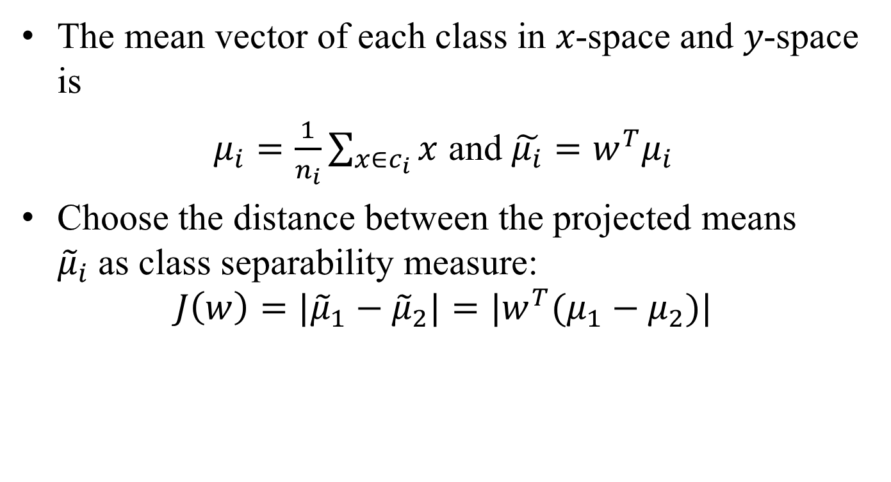
LDA: Two-class
The mean vector of each class in 𝑥-space and 𝑦-space is
$μ_{i}=\frac{1}{n_{i}}\sum_{x∈c_{i}}{x}$ and $\tilde{μ_{i}}=w^{T}μ_{i}$
Choose the distance between the projected means ${\tilde{μ}}_{i}$as class separability measure:
$$J\left(w\right)={|\tilde{μ}}_{1}−{\tilde{μ}}_{2}|=|w^{T}(μ_{1}−μ_{2})|$$

Slide 21
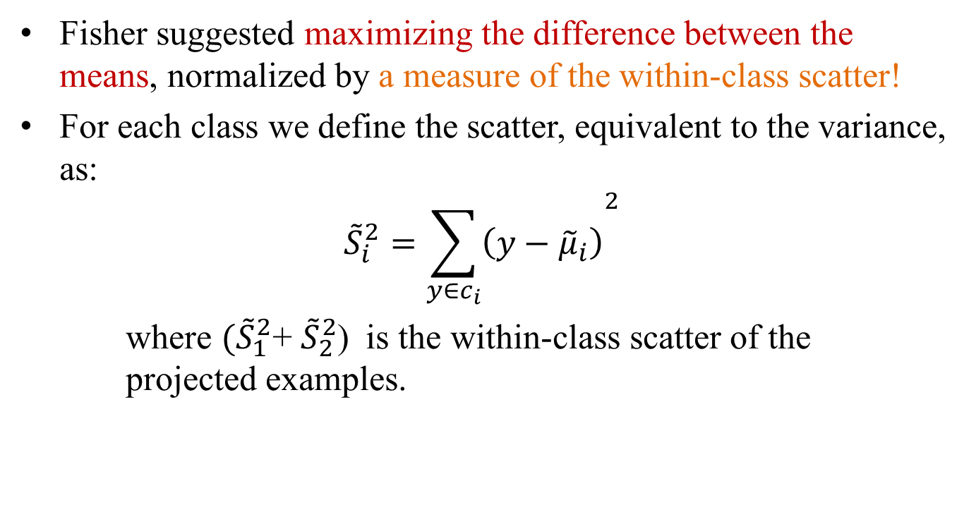
LDA: Two-class
Fisher suggested maximizing the difference between the means, normalized by a measure of the within-class scatter!
For each class we define the scatter, equivalent to the variance, as:
$${\tilde{S}}_{i}^{2}={\sum_{y∈c_{i}}{\left(y−{\tilde{μ}}_{i}\right)}}^{2}$$
where ${(\tilde{S}}_{1}^{2}$+ ${\tilde{S}}_{2}^{2}$) is the within-class scatter of the projected examples.

Slide 22
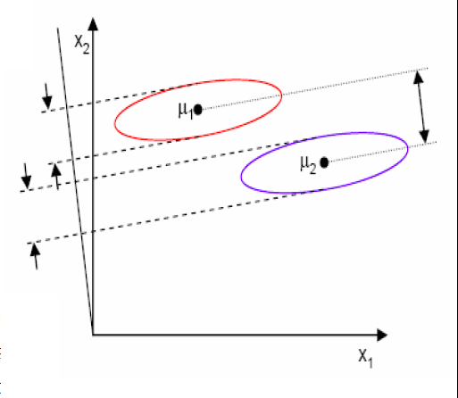

LDA: Two-class
The Fisher linear discriminant is defined as the linear function 𝑤^{𝑇}𝑥 that maximizes the following criterion function:
$$J\left(w\right)= \frac{{\left|{\tilde{μ}}_{1}−{\tilde{μ}}_{2}\right|}^{2}}{{\tilde{S}}_{1}^{2}+{\tilde{S}}_{2}^{2}}$$
Therefore, we are looking for a projection where examples from the same class are projected very close to each other and, at the same time, the projected means are as farther apart as possible
Along this axis, one can
separate two classes better
LDA
Along this axis, one gets larger distance between class means

Slide 23
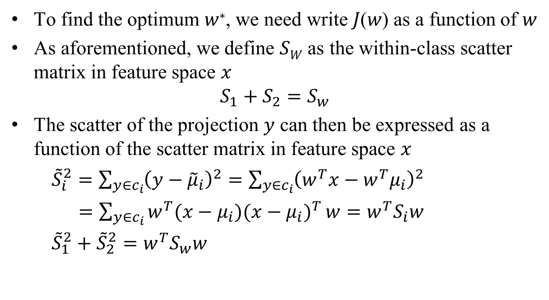
LDA: Two-class
To find the optimum 𝑤∗, we need write 𝐽(𝑤) as a function of 𝑤
As aforementioned, we define 𝑆_{𝑊} as the within-class scatter matrix in feature space 𝑥
$$S_{1}+S_{2}=S_{w}$$
The scatter of the projection 𝑦 can then be expressed as a function of the scatter matrix in feature space 𝑥
${\tilde{S}}_{i}^{2}=\sum_{y∈c_{i}}{{\left(y−{\tilde{μ}}_{i}\right)}^{2}}=\sum_{y∈c_{i}}{{\left(w^{T}x−w^{T}μ_{i}\right)}^{2}}$
$=\sum_{y∈c_{i}}{{w^{T}(x−μ_{i})(x−μ_{i})}^{T}}w=w^{T}S_{i}w$
${\tilde{S}}_{1}^{2}+{\tilde{S}}_{2}^{2}=w^{T}S_{w}w$
Class specific scatter or
covariance matrix
Within class scatter matrix

Slide 24
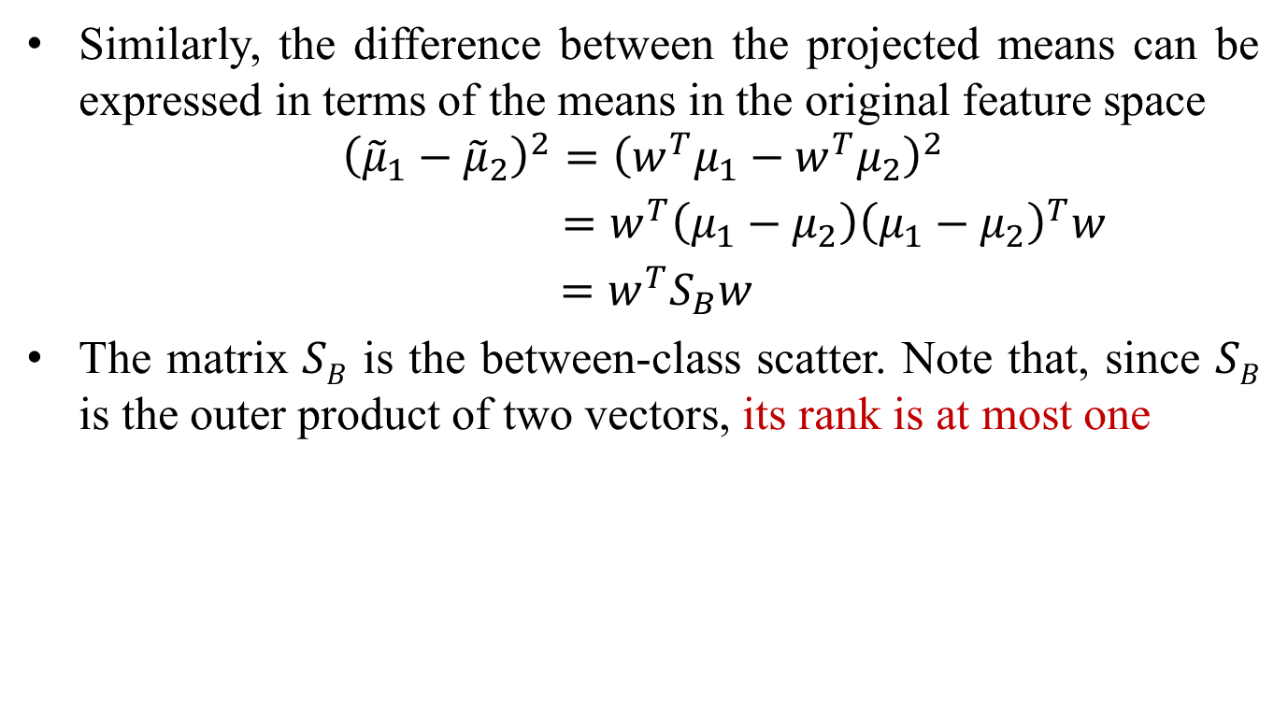
LDA: Two-class
Similarly, the difference between the projected means can be expressed in terms of the means in the original feature space
$${\left({\tilde{μ}}_{1}−{\tilde{μ}}_{2}\right)}^{2}={\left(w^{T}μ_{1}−w^{T}μ_{2}\right)}^{2}$$
$=w^{T}\left(μ_{1}−μ_{2}\right){\left(μ_{1}−μ_{2}\right)}^{T}w$
$=w^{T}S_{B}w$
The matrix 𝑆_{𝐵} is the between-class scatter. Note that, since 𝑆_{𝐵} is the outer product of two vectors, its rank is at most one
Notes:
S_B = (\mu_1-\mu_2)(\mu_1-\mu_2)^top The rank of S_B is at most one.

Slide 25
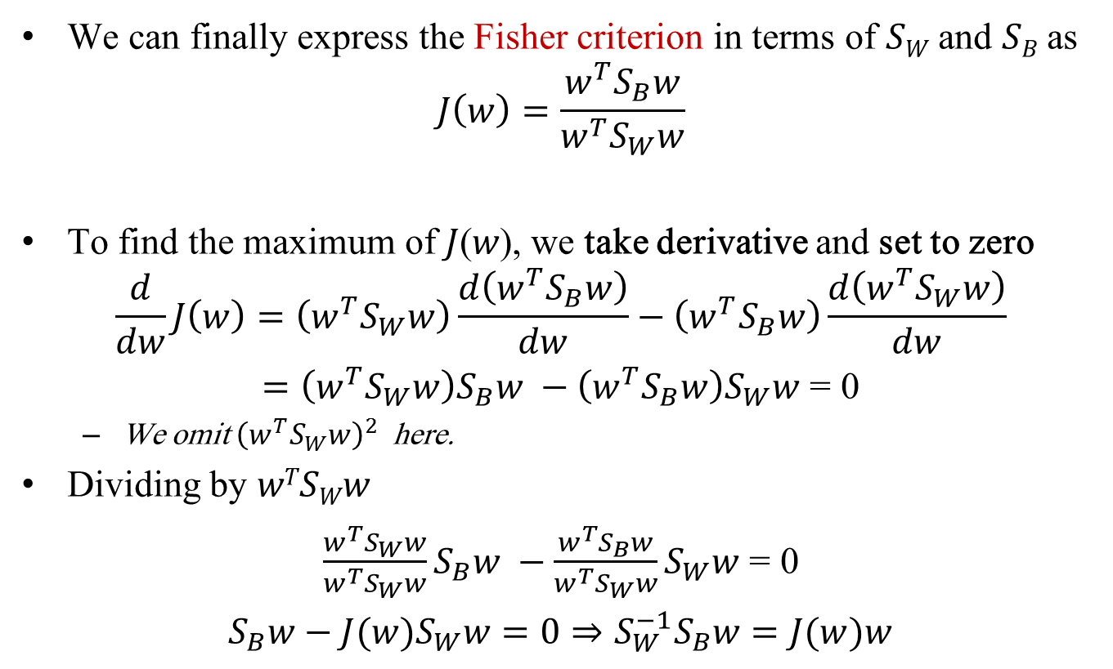
LDA: Two-class
We can finally express the Fisher criterion in terms of 𝑆_{𝑊} and 𝑆_{𝐵} as
$$J\left(w\right)=\frac{w^{T}S_{B}w}{w^{T}S_{W}w}$$
To find the maximum of 𝐽(𝑤), we take derivative and set to zero
$$\frac{d}{dw}J\left(w\right)=\left(w^{T}S_{W}w\right)\frac{d\left(w^{T}S_{B}w\right)}{dw}−\left(w^{T}S_{B}w\right)\frac{d\left(w^{T}S_{W}w\right)}{dw}$$
$=\left(w^{T}S_{W}w\right)S_{B}w −\left(w^{T}S_{B}w\right)S_{W}w$ = 0
We omit ${\left(w^{T}S_{W}w\right)}^{2}$ here.
Dividing by 𝑤^{𝑇}𝑆_{𝑊}𝑤
$\frac{w^{T}S_{W}w}{w^{T}S_{W}w}S_{B}w −\frac{w^{T}S_{B}w}{w^{T}S_{W}w}S_{W}w$ = 0
$S_{B}w−J(w)S_{W}w=0⇒S_{W}^{−1}S_{B}w=J(w)w$

Slide 26

LDA: Two-class
Solving the generalized eigenvalue problem $S_{W}^{−1}S_{B}w=λw, where λ=J\left(w\right)=scalar$
yields w* is the eigenvector of $S_{W}^{−1}S_{B}$

Slide 27
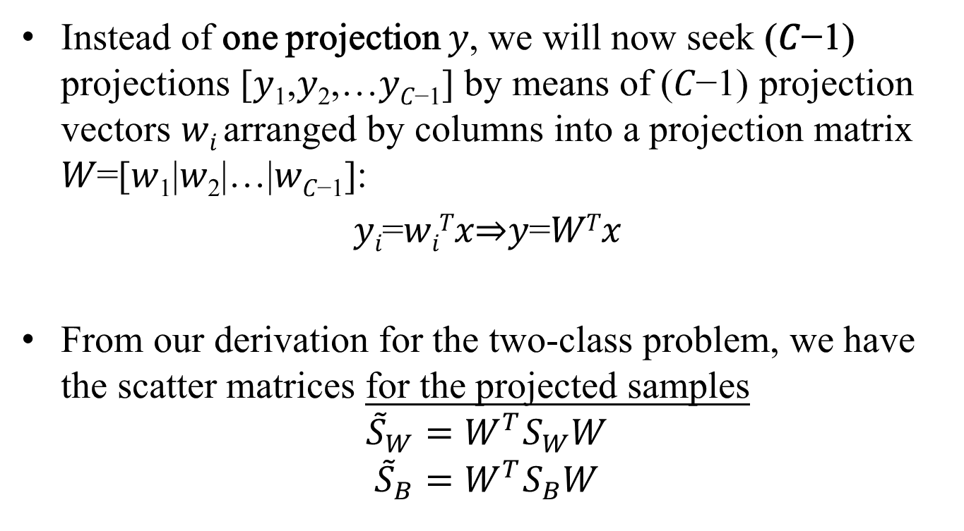
LDA: Multi-class
Instead of one projection 𝑦, we will now seek (𝐶−1) projections [𝑦₁,𝑦₂,…𝑦_{𝐶−1}] by means of (𝐶−1) projection vectors 𝑤_{𝑖} arranged by columns into a projection matrix 𝑊=[𝑤₁|𝑤₂|…|𝑤_{𝐶−1}]:
𝑦_{𝑖}=𝑤_{𝑖}^{𝑇}𝑥⇒𝑦=𝑊^{𝑇}𝑥
From our derivation for the two-class problem, we have the scatter matrices for the projected samples
$${\tilde{S}}_{W}=W^{T}S_{W}W$$
$${\tilde{S}}_{B}=W^{T}S_{B}W$$
Notes:
Every projection direction w_i gives a coefficient y_i. C-1 projection directions give a new representation of (C-1)-dimension.

Slide 28
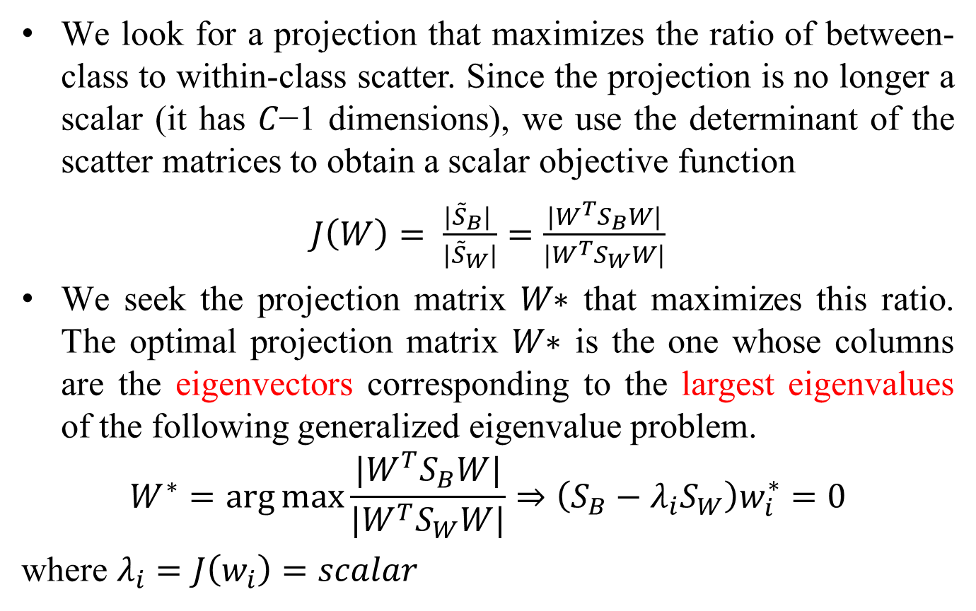
LDA: Multi-class
We look for a projection that maximizes the ratio of between-class to within-class scatter. Since the projection is no longer a scalar (it has 𝐶−1 dimensions), we use the determinant of the scatter matrices to obtain a scalar objective function
$J\left(W\right)= \frac{|{\tilde{S}}_{B}| }{{|\tilde{S}}_{W}|}=\frac{|W^{T}S_{B}W|}{|W^{T}S_{W}W|}$
We seek the projection matrix 𝑊∗ that maximizes this ratio. The optimal projection matrix 𝑊∗ is the one whose columns are the eigenvectors corresponding to the largest eigenvalues of the following generalized eigenvalue problem.
$$W^{∗}=\arg{\max{\frac{|W^{T}S_{B}W|}{|W^{T}S_{W}W|}⇒\left(S_{B}−λ_{i}S_{W}\right)w_{i}^{∗}=0}}$$
where $λ_{i}=J\left(w_{i}\right)=scalar$
Why use determinant?
Notes:
Note:

Slide 29
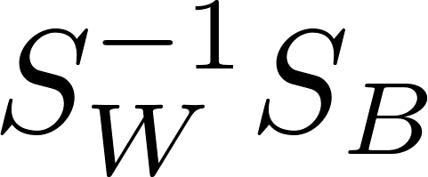
Some Remarks
Solving LDA is lightweight.
We can see that if an optimization problem can be solved as a Generalized Eigenvalue Decomposition problem with and being the i-th eigenvector and eigenvalue of .
Unlike principal component analysis (PCA), the linear discriminant transformation W from the original variates to the new variates is not necessarily orthogonal.
Because may not be symmetric.

Slide 30
Classification with LDA
First, select the number of feature dimension for the low-dimensional feature space (may use PCA beforehand).
Later, use Nearest Neighbor or other classifiers.

Slide 31

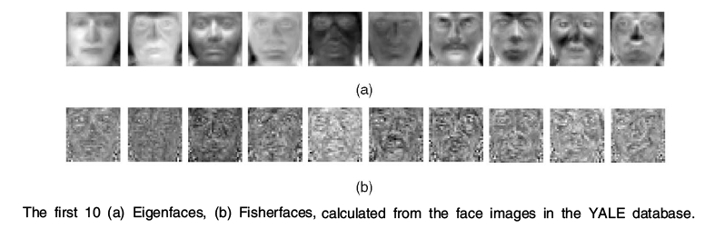
Basis Visualization
Sample Images from YALE database
(visualization of LDA projection is called Fisherface)

Slide 32
Question
Shall LDA always be better than PCA for classification task?

Slide 33
Is LDA always better than PCA?
Case Study: PCA versus LDA
A. Martinez, A. Kak, "PCA versus LDA", IEEE Transactions on Pattern Analysis and Machine Intelligence, vol. 23, no. 2, pp. 228-233, 2001.
Is LDA always better than PCA?
There has been a tendency in the computer vision community to prefer LDA over PCA.
This is mainly because LDA deals directly with discrimination between classes while PCA does not pay attention to the underlying class structure.
This paper shows that when the training set is small, PCA can outperform LDA.
When the number of samples is large and representative for each class, LDA outperforms PCA.

Slide 34
Linear Discriminant Analysis (LDA)
Is LDA always better than PCA? – cont.

Slide 35
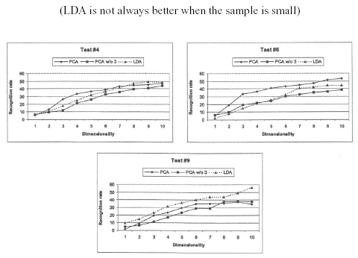
Linear Discriminant Analysis (LDA)
Is LDA always better than PCA? – cont.
Results on a small dataset for training: 2 images for training and 5 images for testing.
PCA w/o 3: PCA without using the top 3 eigenvectors. #i index train/test splits

Slide 36
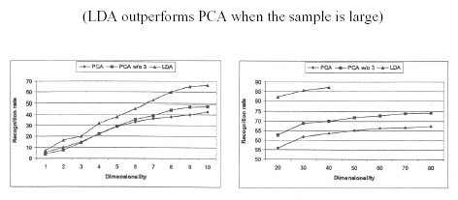
Linear Discriminant Analysis (LDA)
Is LDA always better than PCA? – cont.
Results obtained for each of the three algorithms using a larger data set for training.

Slide 37
Limitations
LDA produces at most 𝐶 − 1 feature projections
If the classification error estimates establish that more features are needed, some other method must be employed to provide those additional features
LDA is a parametric method (it assumes unimodal Gaussian likelihoods)
If the distributions are non-Gaussian, LDA projections may not preserve complex structure in the data needed for classification

Slide 38
Limitations
LDA does not seem to be superior to PCA when the training data set is small.
If testing sample does not follow the distribution of the training samples, the performance may be worse

Slide 39
Papers to Read and Study
Jieping Ye, Ravi Janardan, Cheonghee Park, and Haesun Park. An optimization criterion for generalized discriminant analysis on undersampled problems. IEEE Transactions on Pattern Analysis and Machine Intelligence. Vol. 26, No. 8, pp. 982—994, 2004. PDF
A. Martinez, A. Kak, "PCA versus LDA", IEEE Transactions on Pattern Analysis and Machine Intelligence, vol. 23, no. 2, pp. 228-233, 2001.

